Slide 1
AUTOMATED DRIVER DROWSINESS DETECTION SYSTEM
Major Project End Term
Group 49
Under the Supervision of
Dr. HIMANSHU AGRAWAL

Slide 2
INTRODUCTION
In this system, we will work towards making a real time warning system for drowsy drivers by using various theorems and ratios like EAR (Eye Aspect Ratio). The system will be implemented in python language and further it will be using flask for converting this system into a web application.
Halting drowsiness requires a mechanism to identify the diminishing sight of the driver due to drowsiness. Diminished alertness is measured by evaluating the driver’s eye features and states, whether the eyes are fully closed, partially closed of fully open for a given frame rate. This detection system will try using a non-contact approach for judging the degree of driver alertness by the amount of eyes open or closed. If the eye aspect ratio for five continuous frames satisfies given condition of the threshold, then the driving force could be detected as drowsy.

Slide 3
PROBLEM STATEMENT
During long journeys, it is possible that the driver may lose attention because of drowsiness, which may be a potential reason for fatal accidents. Therefore, we need a system for detecting drowsiness and avoid these accidents. We intend the proposal to implement an Automated Drowsiness Detection System for protection of user and secure vehicle access which will generate a penalty over the driver found drowsy during working hours and preventing the intruders to access the vehicle by appropriate authentication.

Slide 4

SIGNIFICANCE
During long journeys, it is possible that the driver may lose attention because of drowsiness, which may be a potential reason for fatal accidents. With systems like automated Driver Drowsiness Detection it is possible to detect driver’s body activities while driving that may prove hazardous to the people sitting in the vehicle or around them. The proposed system will decrease the number of road accidents and also give the current cab service providers a technological edge.
After procuring the live streaming of the driver’s face, the system will convert it into frames for further processing. The Local Binary Pattern(LBP) algorithm will be applied for the detection of the face portion in the image i.e. the eyes Drowsiness will be determined from whether the eyes of the driver are closed for an instance of seconds. Through analysis of the eye states, the system will be able to differentiate a drowsy driver from a normal driver. Classifiers will then classify the state of the eye features and face location of the driver. If a drowsy driver is detected an alarm will be raised, until the system notices the driver is alert.

Slide 5
ANALYSIS, DESIGN AND MODELLING
The proposed system of automated driver drowsiness detection system is a system to detect fatigue in driver of the vehicle by localizing the eye states and computing the eye aspect ratio and subsequently activating the alarm in case of activities like drowsiness. The alarm and a LED will be activated in case the eye aspect ratio is found less than the set threshold. We will work in Python and apply EAR theorem (eye aspect ratio) to detect eye states. The implementation of the final output will be done by using flask. At very first level we will detect the face using libraries like dlib, OpenCv. Further eye detection will take place and then the EAR algorithm will be applied and results will be calculated and output using flask.

Slide 6
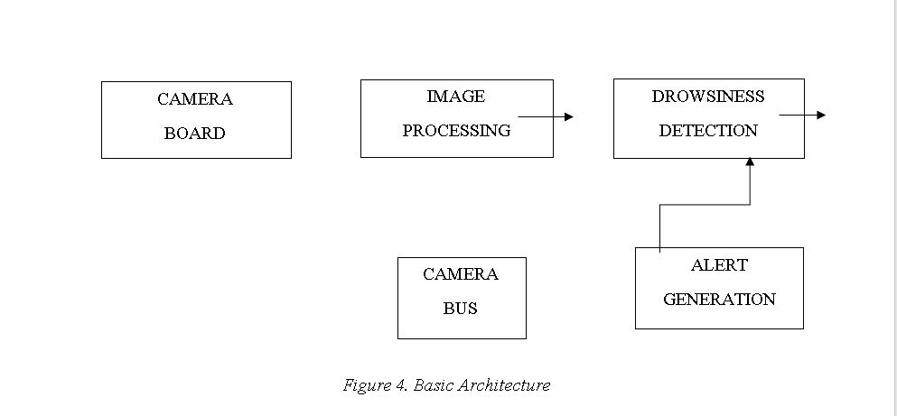
DESIGN DIAGRAM

Slide 7
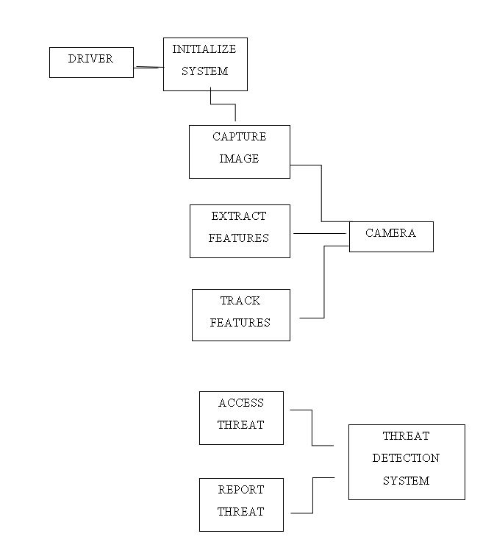
USE CASE DIAGRAM

Slide 8
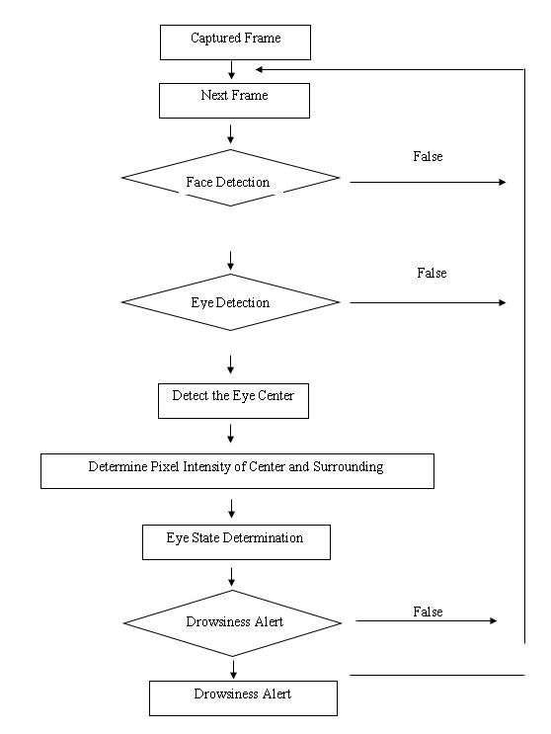
CONTROL FLOW

Slide 9
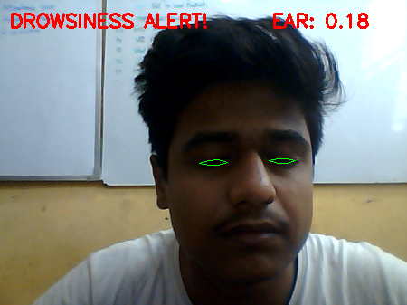
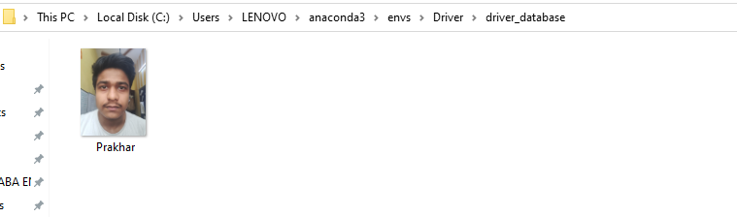
OUTPUT
EAR CLOSED
DRIVER DATABASE

Slide 10
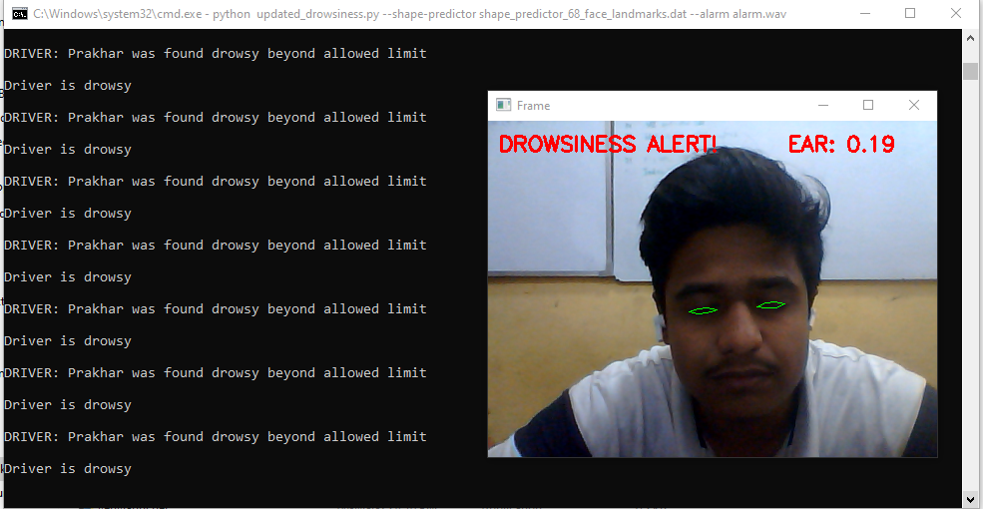
OUTPUT
DROWSINESS ALERT

Slide 11
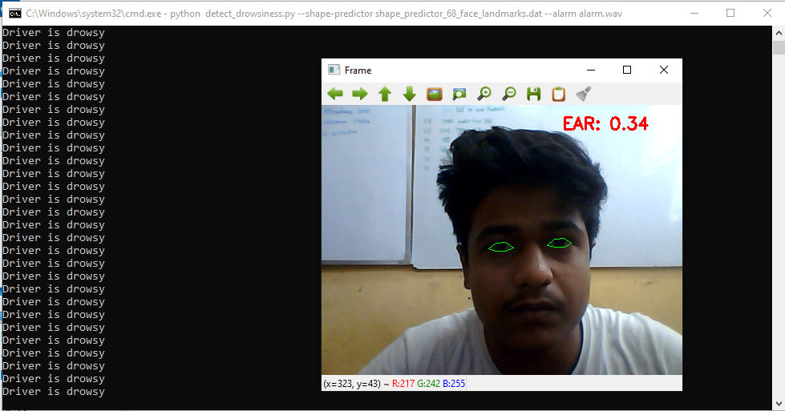
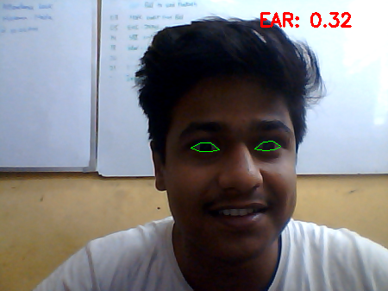
OUTPUT
EAR OPEN- NO ALERT

Slide 12
THANK YOU
GROUP-49
PRAKHAR JAUHARI 9919103206
SHIKHAR GUPTA 9919103219
MANAV CHOUDHARY 9919103222

